Slide 1
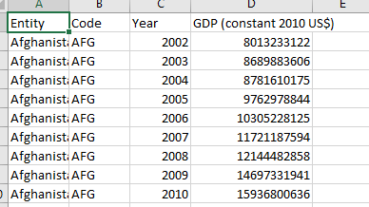
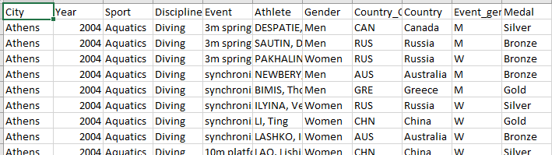
Data Sources
Gross domestic product adjusted for price changes over time (inflation) and expressed in US-Dollars.
Summer Olympics Medals (1976-2008)
11256 Data Rows
15316 Data Rows

Slide 2
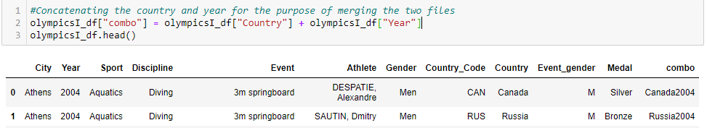
Merging
We concatenated the country and year to create a merge point for both files.
We used a left merge on the country-year combo.

Slide 3
Cleaning
Due to name changes of Eastern European Countries; GDP is missing for certain entries
Dropping Missing Data
Correcting Country Names to match GDP
Fixing big gap in csv file
Dropping duplicate columns (country names, codes)
Creating a function for assigning host country (not just city)
Converting file types to match
Data rows with missing GDP were left in so medal analysis could still be completed

Slide 4
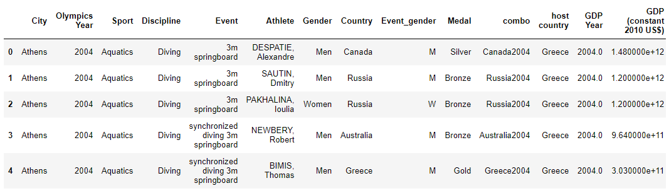
Cleaned DataFrame

